Slide 1


XN PROJECT FINAL PRESENTATION
ALY 6080​ Prof. Atherley Valarie
06/29/2021
By
Group 5
Sunil Raj Thota
Sashank Yakkali
Feng Gao

Slide 2
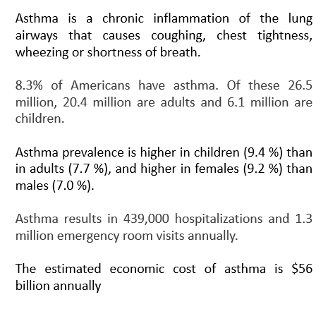
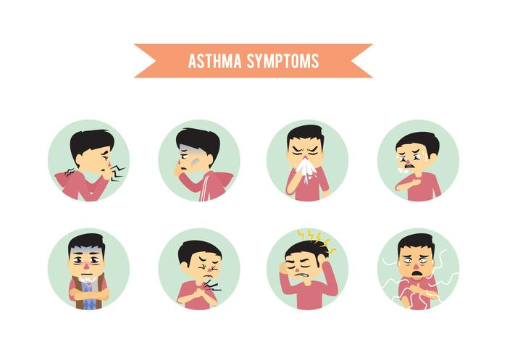
Facts

Slide 3
Criteria Air Pollutants
Carbon
Monoxide
Lead
Nitrogen Oxides
Ozone
Particle Pollution
Sulfur Oxides

Slide 4
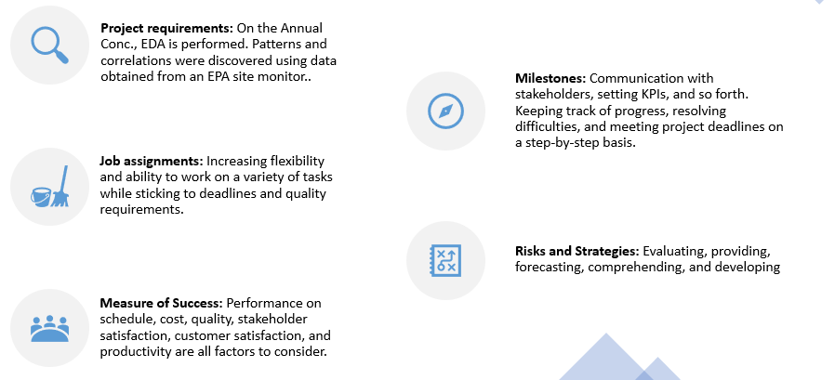
Introduction

Slide 5
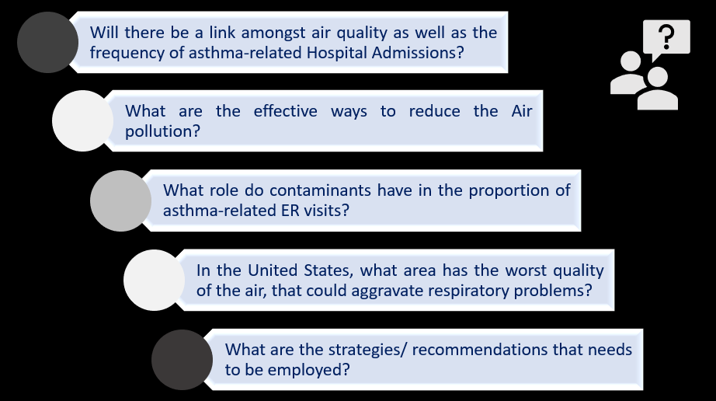
Business Questions

Slide 6
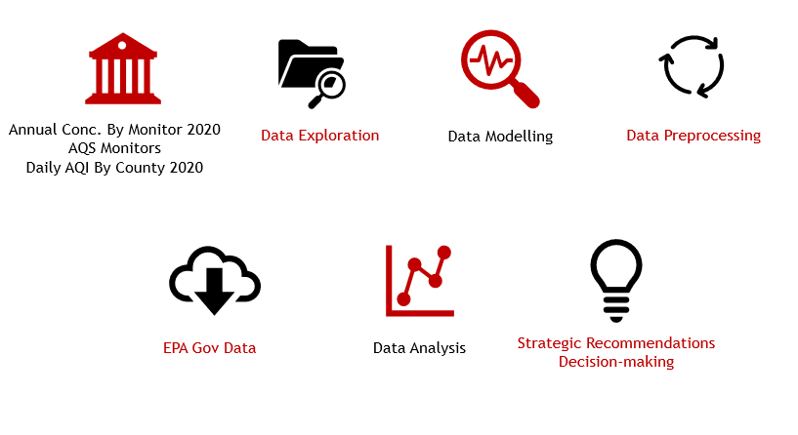
Exploratory Data Analysis

Slide 7










Tools

Slide 8
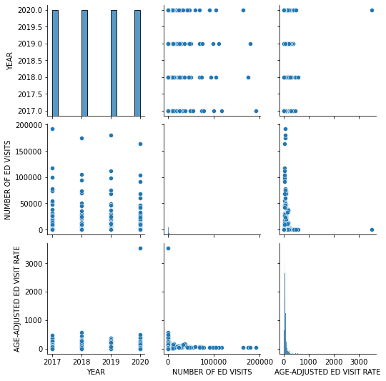
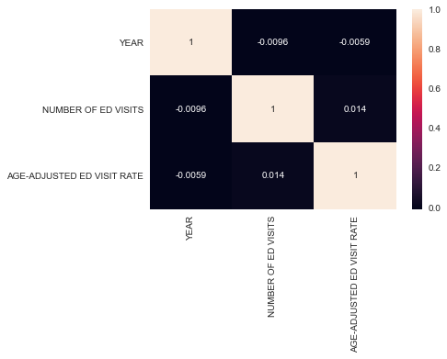
Analysis in Python

Slide 9
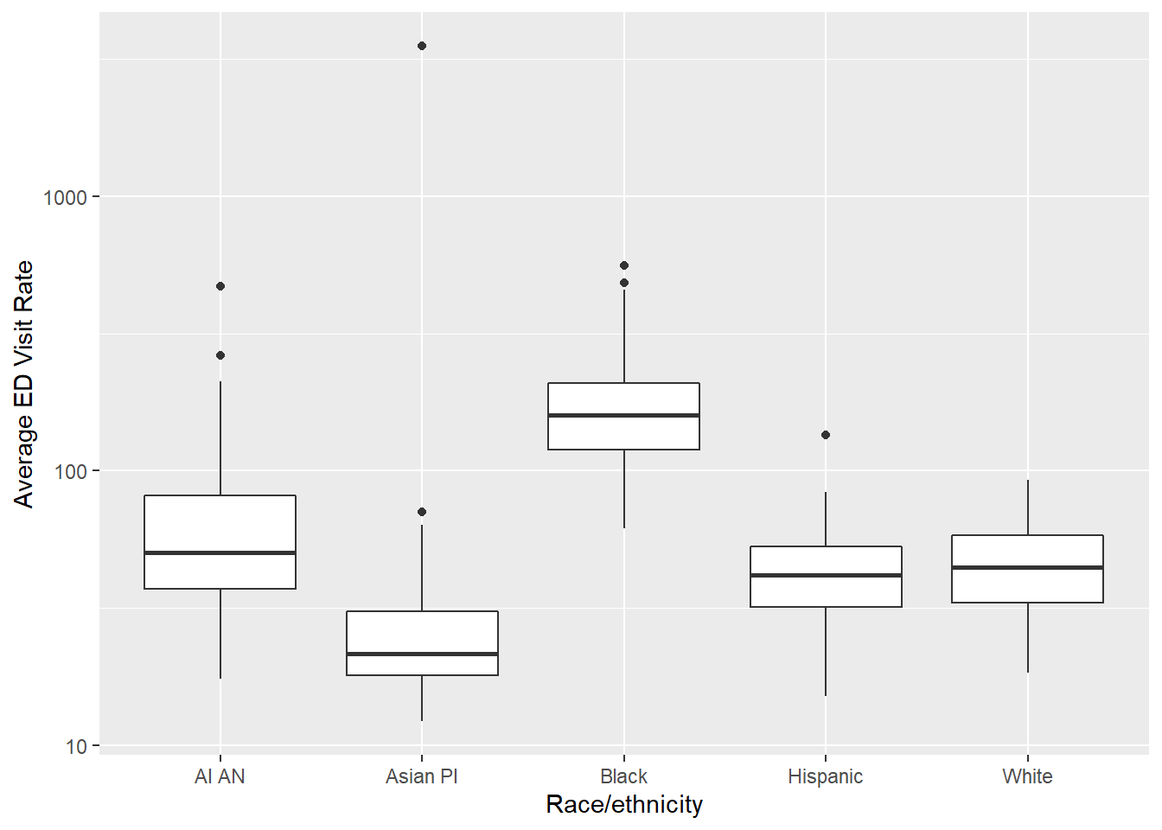
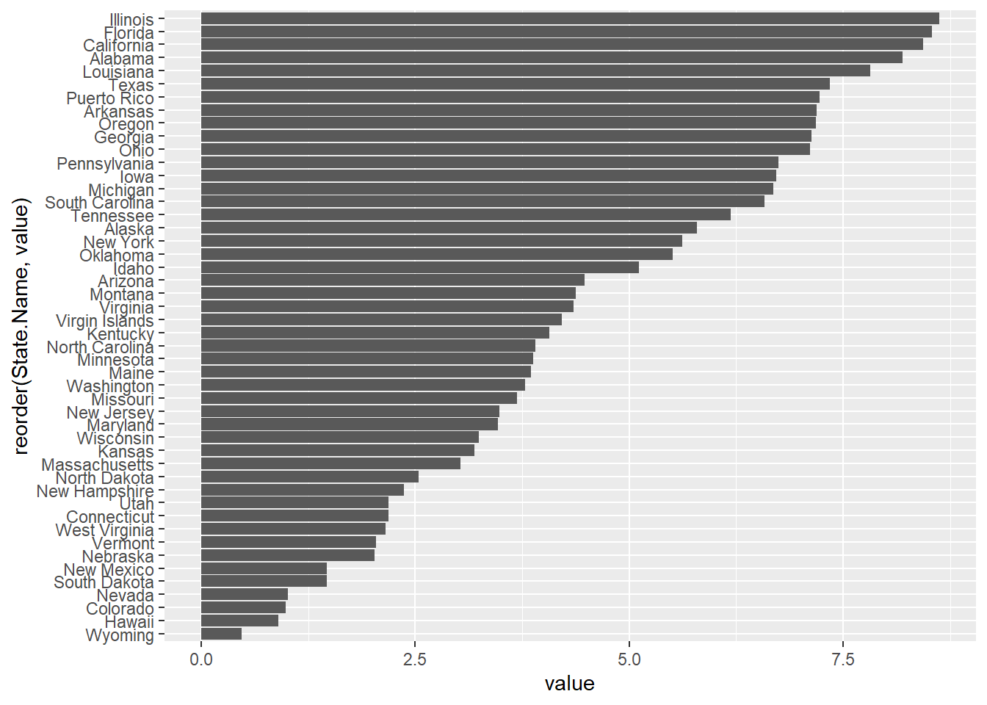
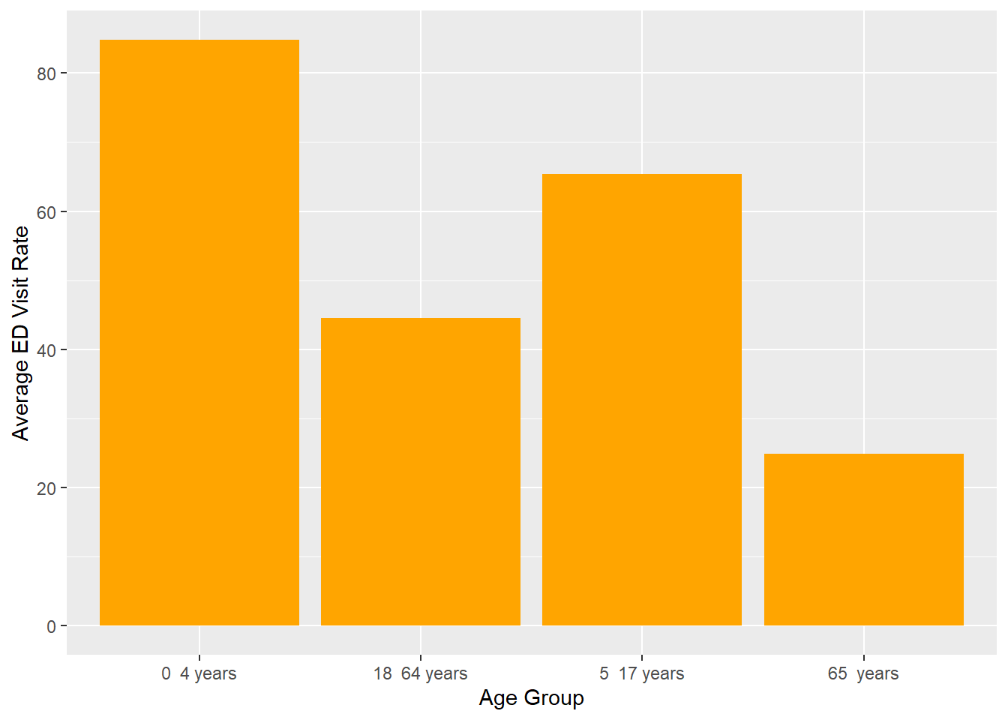
Analysis in R

Slide 10
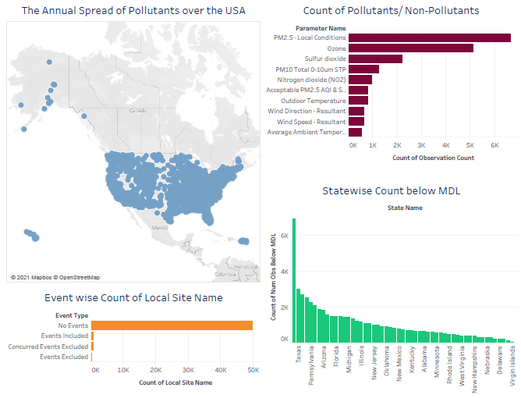
Analysis in Tableau

Slide 11
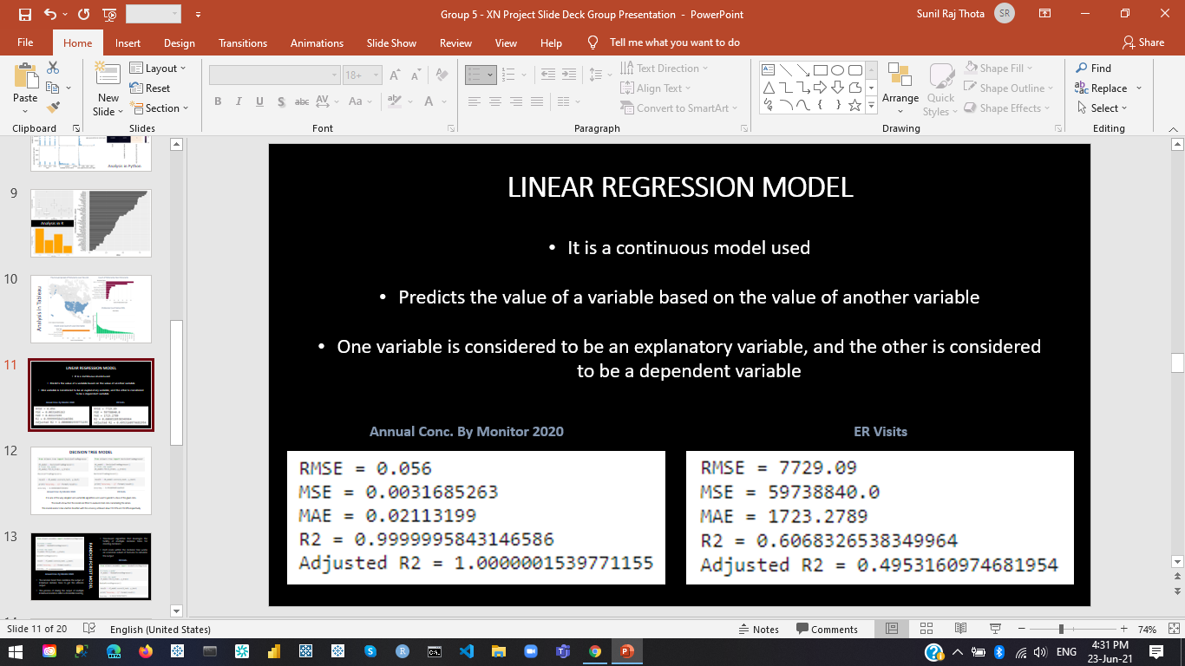
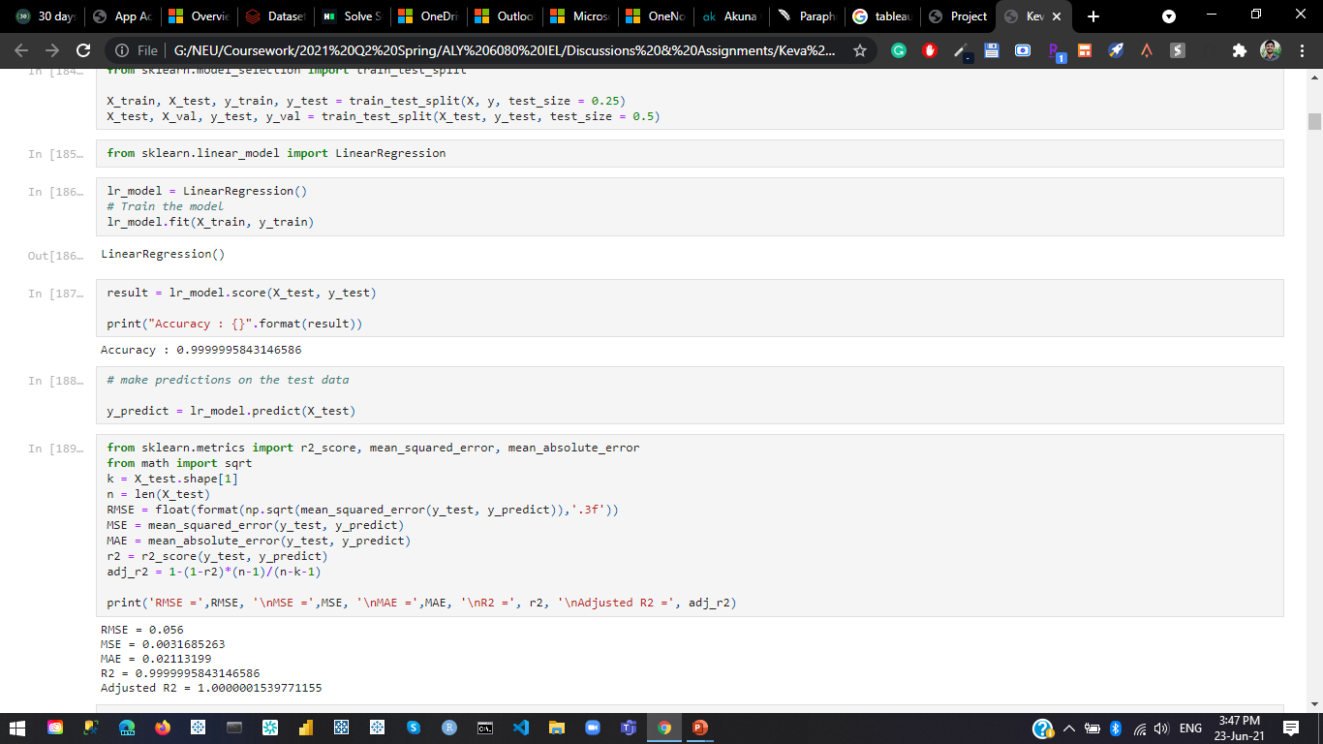
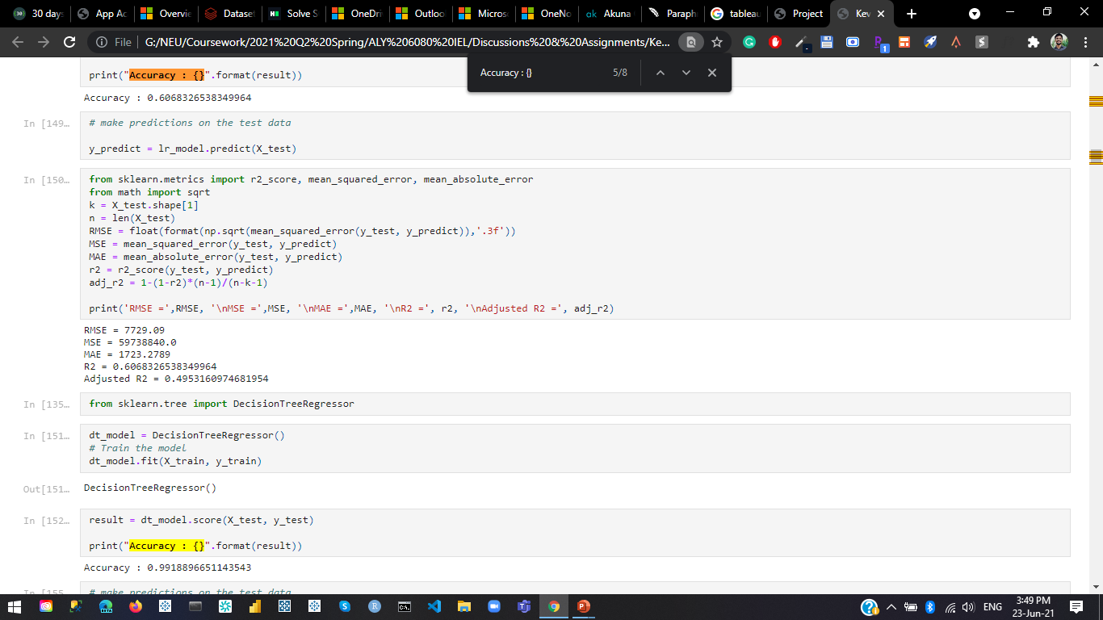
Linear Regression Model
Annual Conc. By Monitor 2020 ER Visits

Slide 12
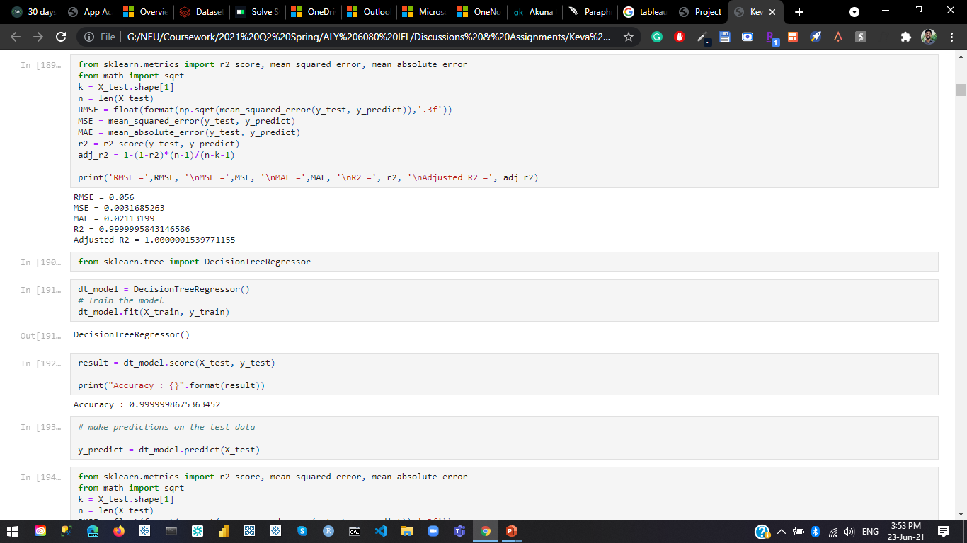
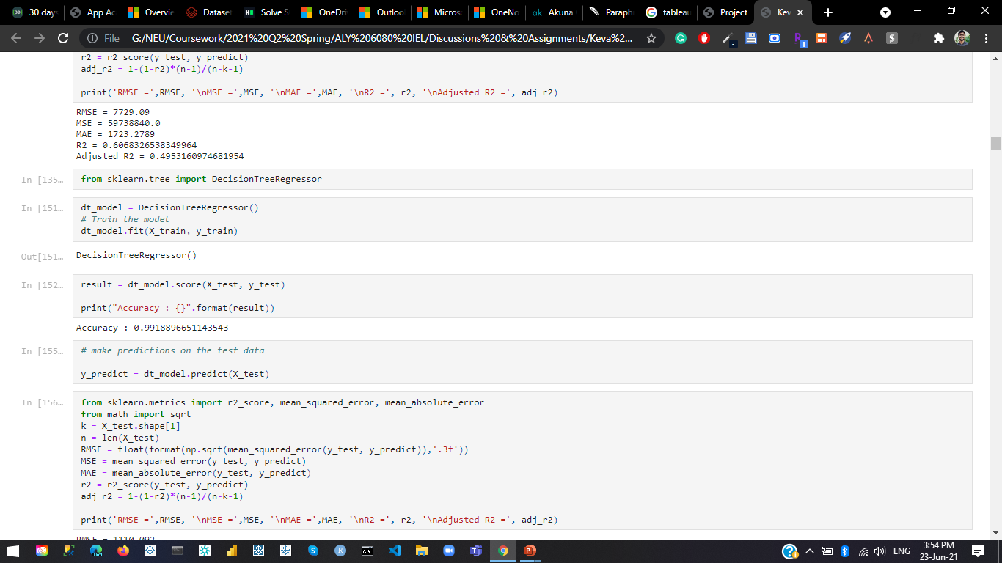
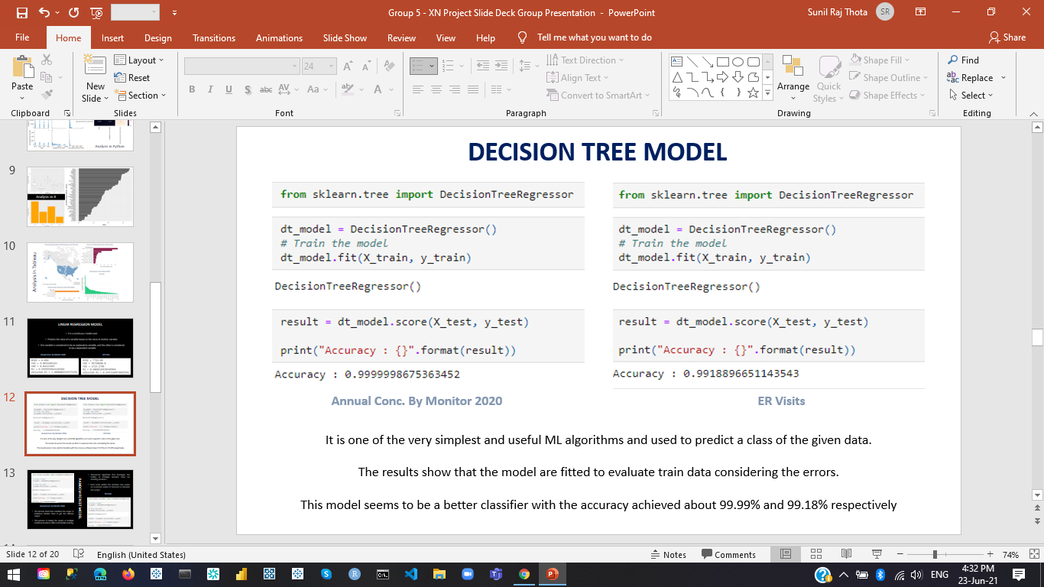
Decision Tree Model
Annual Conc. By Monitor 2020 ER Visits

Slide 13
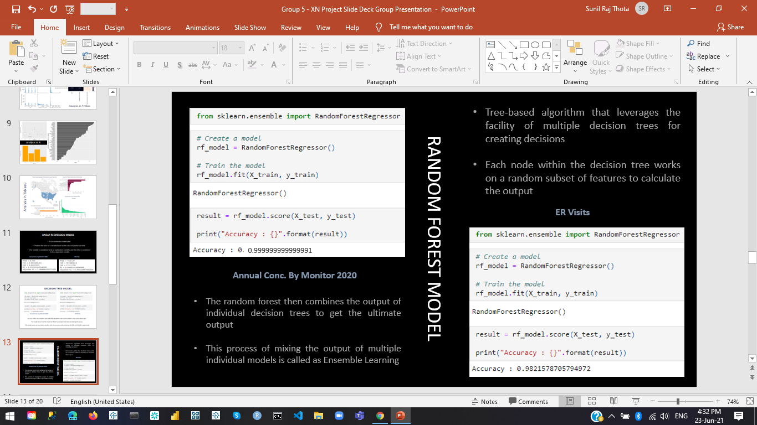
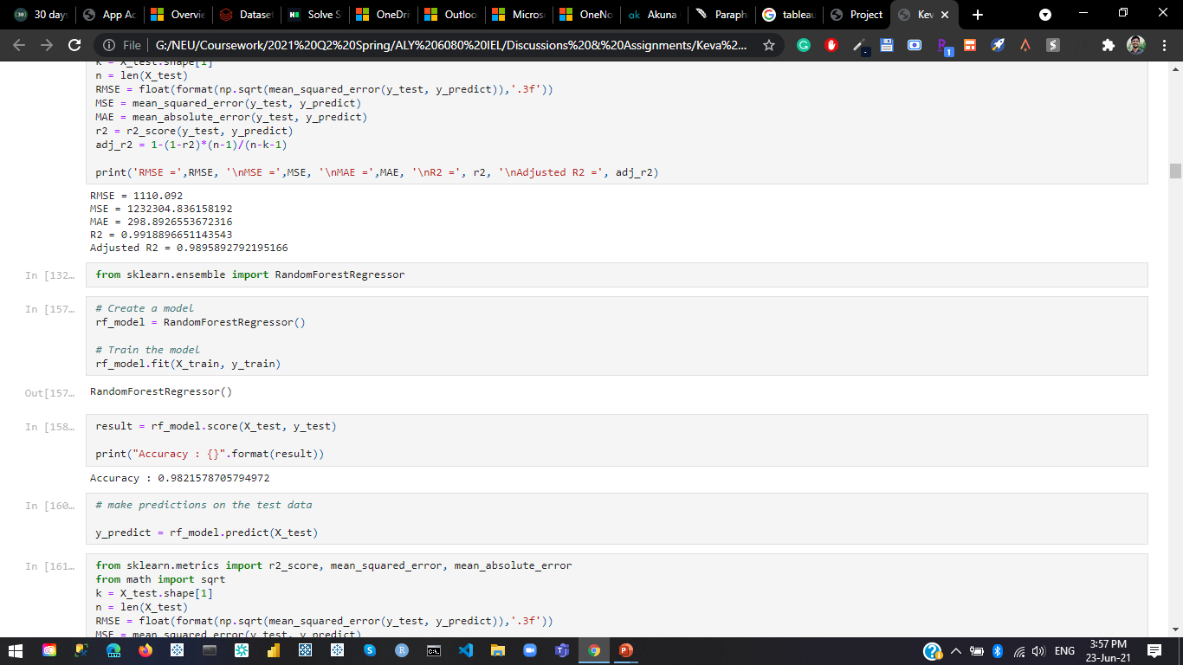
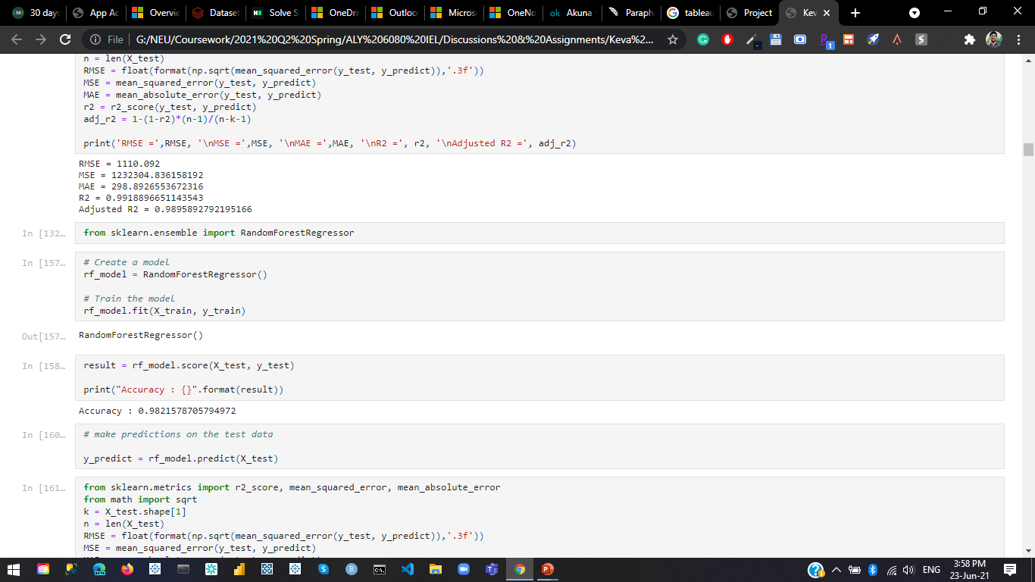
ER Visits
Random Forest Model
0.999999999999991
Annual Conc. By Monitor 2020

Slide 14
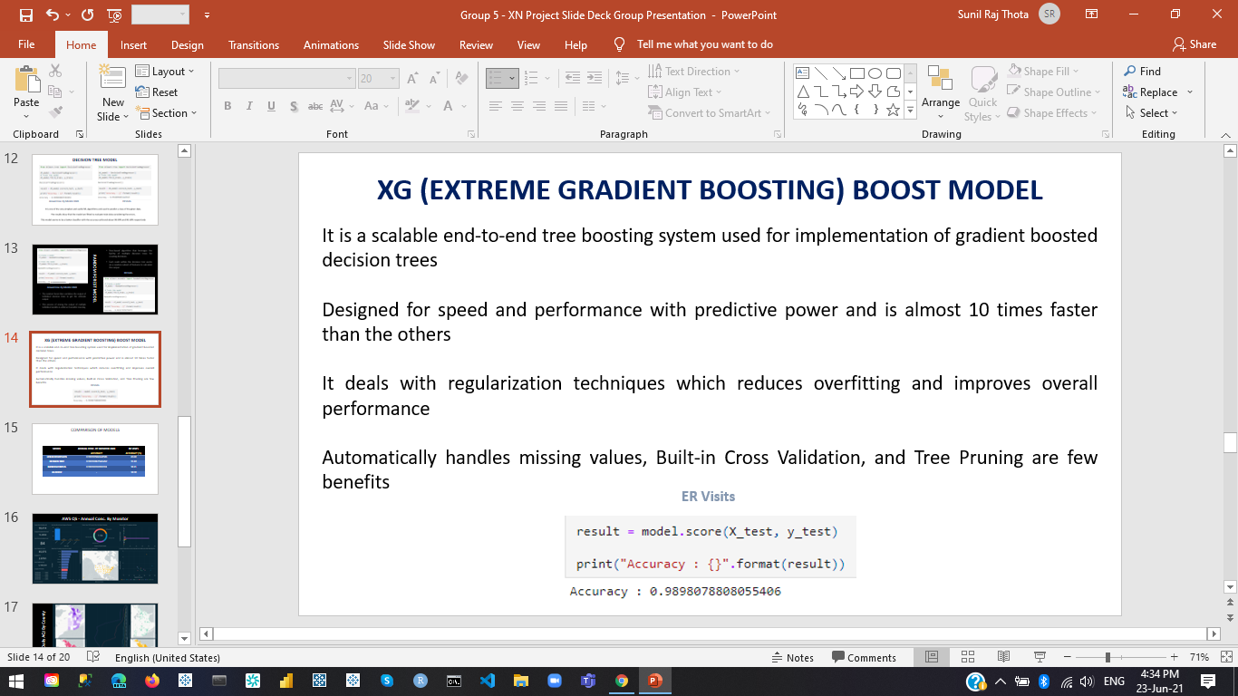
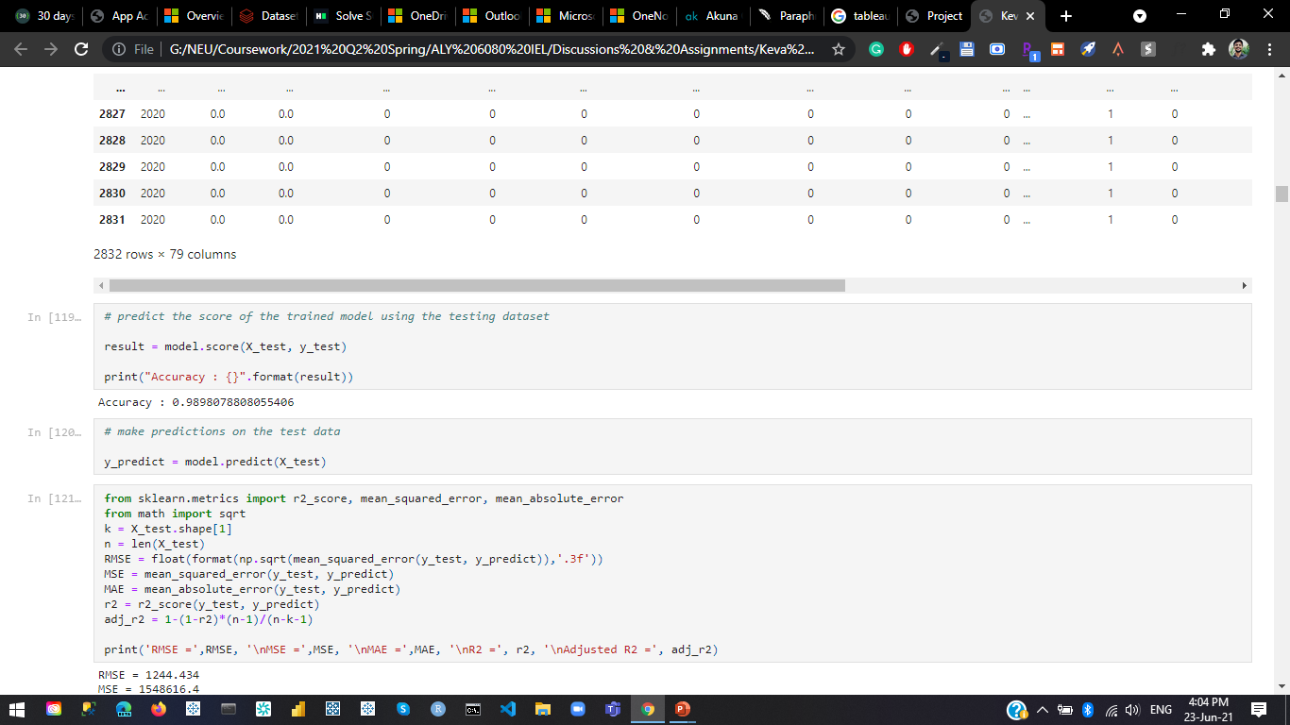
XG (Extreme Gradient Boosting) Boost Model

Slide 15
Comparison Of Models
MODEL | ANNUAL CONC. BY MONITOR 2020 ACCURACY | ER VISITS ACCURACY (%)
LINEAR REGRESSION | 0.9999995843146586 | 60.68
DECISION TREE | 0.9999998675363452 | 99.18
RANDOM FORESTS | 0.9999999999999991 | 98.21
XG BOOST | - | 98.98

Slide 16
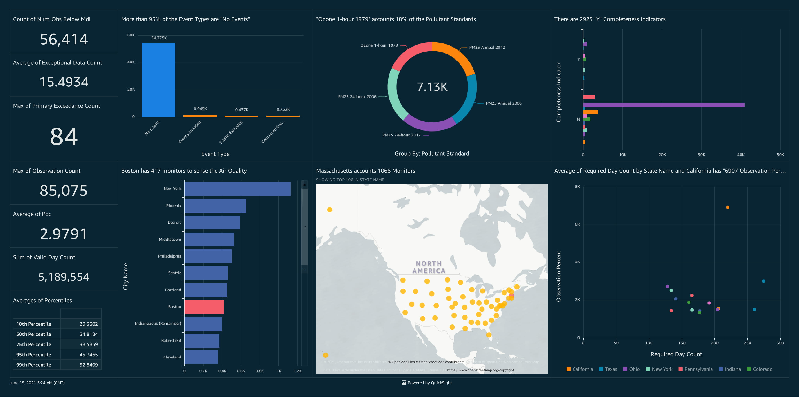
AWS QS - Annual Conc. By Monitor

Slide 17
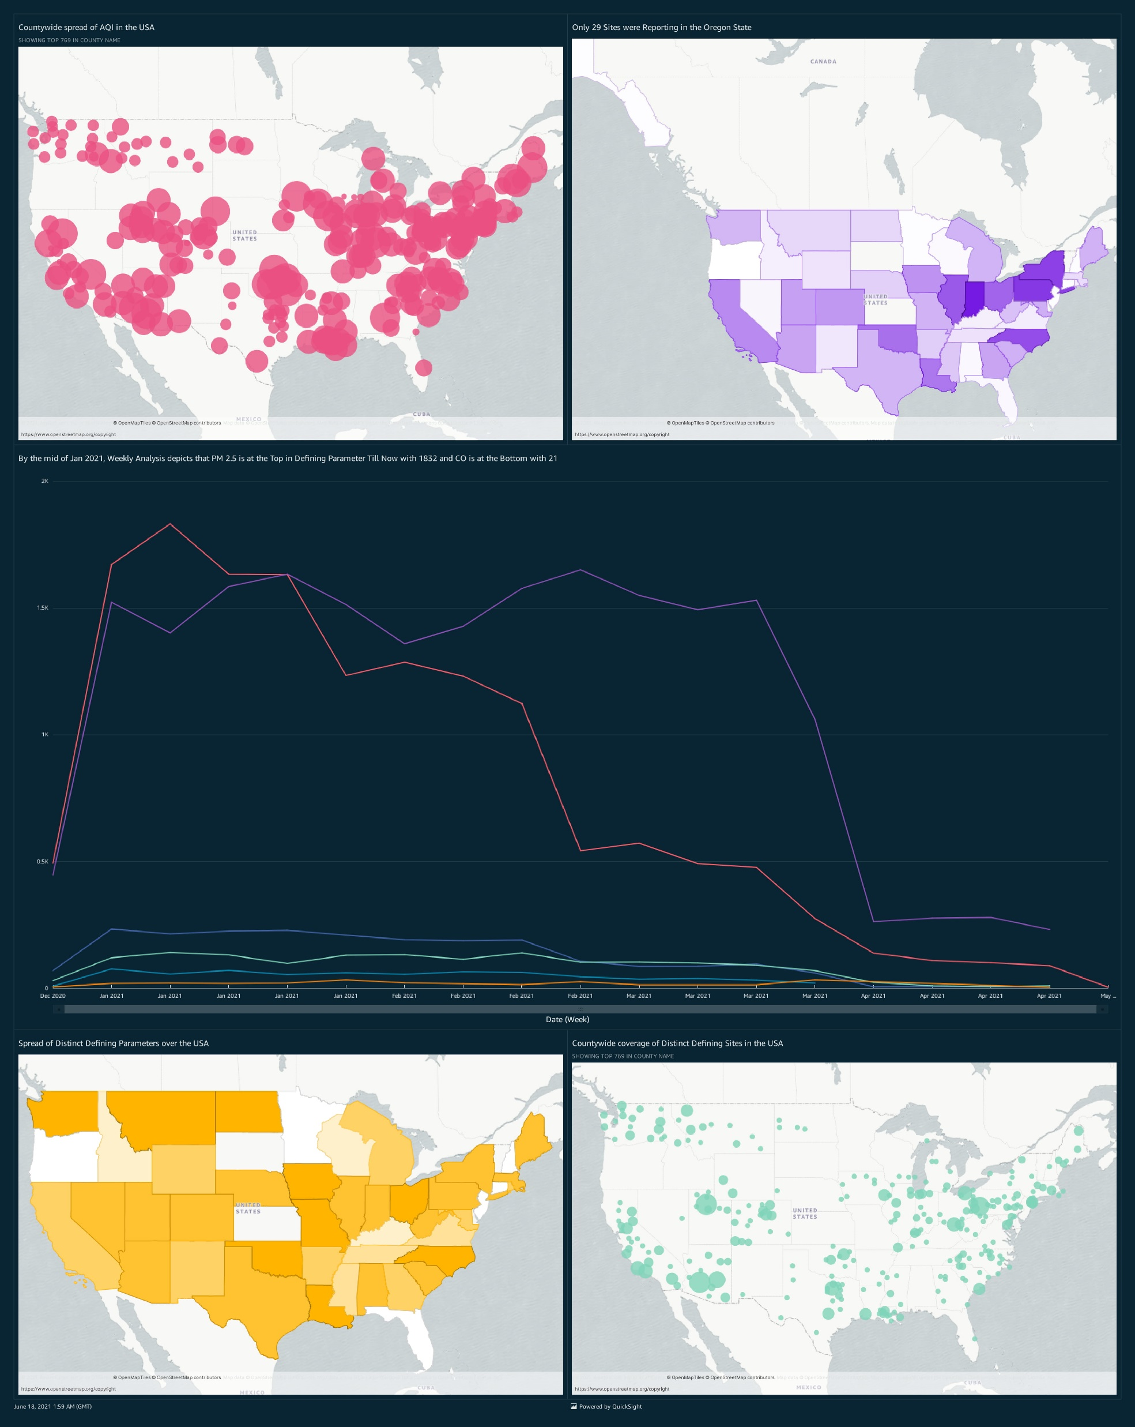
AWS QS - Daily AQI By County

Slide 18
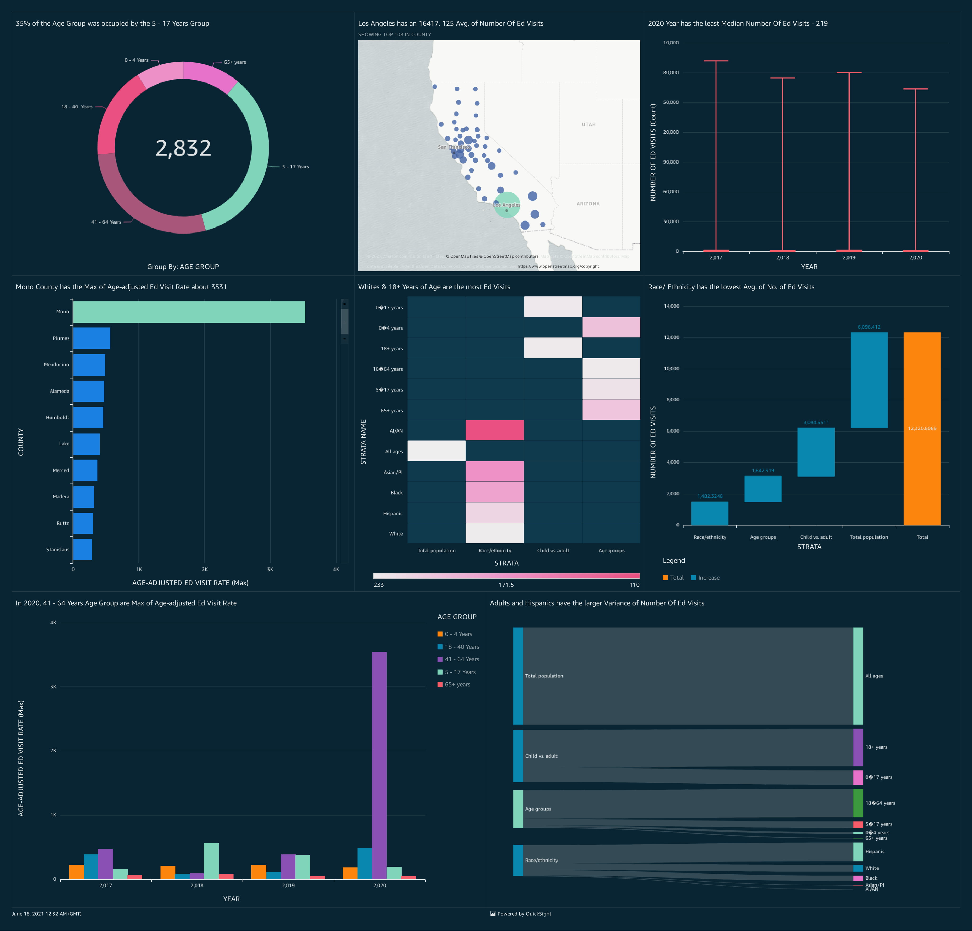
AWS QS - ER Visits Analysis

Slide 19
Conclusion
A roadmap helps you and your team get closer to the finish line by visualizing the important components of the project plan.
When we go further into the information, we gain new insights. For nearly 80% of our time, we'll be using EDA to analyse data and solve different business challenges.
We also want to use machine learning algorithms to predict how asthma problems will turn out.
We'll use the Visualization Dashboard to evaluate and present the data in the future.
Look for datasets on emergency room visits on various other states that are available to the public and download the air now datasets.
Analyse the impact of air quality on asthma patients by performing an investigation and creating a graphic representation.
Recommendations for using this information to help asthma patients

Slide 20
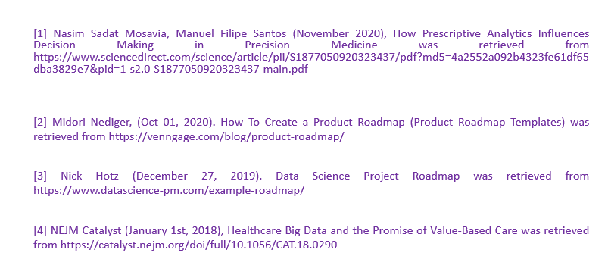
References

